Slide 1




Evaluation Research with Refugee Youth: Adapting Methods to the Population
Karen Block, Lisa Gibbs, Elisha Riggs, Deborah Warr
McCaughey Centre, Melbourne School of Population Health,
University of Melbourne
The Australasian Evaluation Society International Conference, Sydney 2011

Slide 2
Overview of presentation
Background
  Multiple barriers to inclusion for refugee youth settling in Australia
  Ucan2 program
Evaluation research
  Evaluation of organisational partnerships
  Economic Evaluation
  Participant experience of the program

Slide 3
Barriers to inclusion for refugee-background youth
Consequences of refugee background
  disrupted family and social networks
  impacts of trauma on physical and mental health
  minimal or significantly disrupted formal education
  discrimination, insecure housing, poverty
Current on-arrival systems
  6-12 months English language tuition before ‘integration’ into mainstream education and training
  high risk of disengagement from mainstream systems
  poor employment prospects
  risk of long term welfare dependency and social exclusion

Slide 4
Ucan2 program
Multi-agency partnership program
Newly-arrived young people with refugee backgrounds aged 16-24
Situated within on-arrival English language classes
  psychosocial support in a group setting
  promotes broader social networks
  employment focused curriculum
  group activities; volunteers in the classroom; work experience; part time work opportunities

Slide 5
Conceptual framework
(Ager and Strang 2008)

Slide 6
Ucan2 evaluation - methodology
Economic Evaluation of Ucan2
Ucan2 Evaluation
Evaluation of Ucan2 organisational partnerships
Explore resettlement experiences
Qualitative data
Evaluation of participant experience of Ucan2
Impact of Ucan2 program
Social network maps and wellbeing surveys
Quantitative data
Qualitative data

Slide 7
Immersion in the field
Literature review
Ethnographic approach
  weekly staff meetings and partner meeting
  multiple visits to each Ucan2 site where program is being delivered
  Participation and Observation
Comparison group?

Slide 8
Data collection
Social network and wellbeing surveys
  at beginning and end of six-month program
  all program participants (215 over 4 program cycles)
Focus groups
  14 Ucan2 groups
  explore experiences of resettlement for refugee youth
  Impact of Ucan2 program on those experiences
Individual interviews
  purposive sampling (culture of origin, age, family structure, gender – approx 20)
  explore themes in greater detail

Slide 9
Methodological and ethical challenges
Tension between facilitated access and voluntary participation
Vulnerability of target population
Building and maintaining trust
Informed consent
Imbalance of power between researcher and participants
Maximising inclusion and agency in research process
Potential for tension between rigour and advocacy

Slide 10
Respect for autonomy
Informed and meaningful consent
Multiple first languages (38)
Written translations?
  Resources
  Literacy?
Interpreters?
  Impractical with multiple languages
  Translating language not the same as translating concepts
English most suitable but limited proficiency

Slide 11
Understandings of research
Piloted research methods…
Signed consent form not the same as ‘meaningful consent’
Little understanding of what is being consented to
Voluntary and informed consent involves:
‘culturally bound, western values of individual autonomy, self-determination, and freedom’
(Ellis et al 2007)

Slide 12
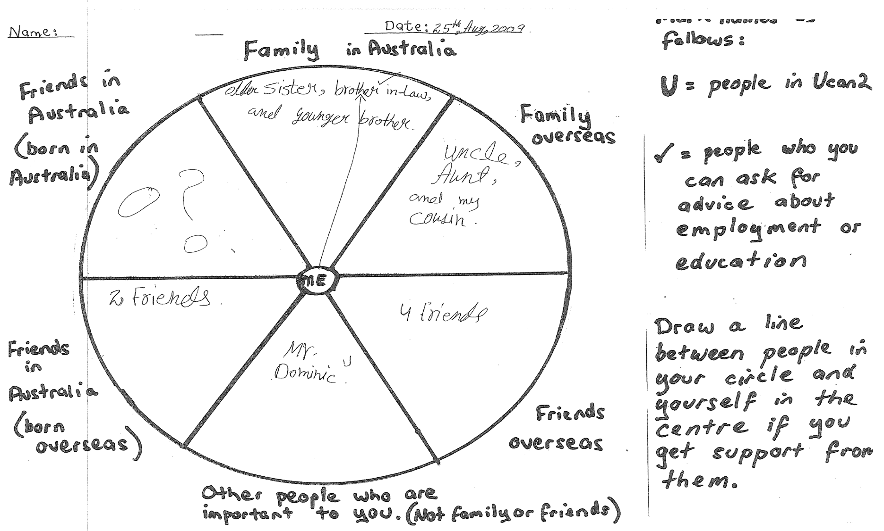
Social network mapping
Adapted from Gifford et al (2007)

Slide 13
Maximising benefits and minimising harms
Disrupted and limited social networks
  potential for participants to feel confronted, inadequate or distressed
  responded by repositioning the evaluation activity as part of psychosocial support component of program
Explain purpose within context of the aims of Ucan2
  extend social connectedness
  think about social connections as resources

Slide 14
Benefits and harms
Activity now includes debriefing discussion with the program staff who run the psychosocial support component of the program
Discuss:
  common within group to have absent family and friends
  associated feelings
  different ways that group members use to keep in touch with those overseas
Locates the evaluation activity within part of the program aimed at “normalising” the refugee experience

Slide 15
‘Informed’ consent
Participants now in a better position to understand what it is they are consenting to
Explain that we would like to use the social network maps and surveys for our evaluation
Reiterate aims of evaluation
  discuss voluntary and ongoing nature of consent
  confidentiality
Time for questions and discussion

Slide 16
Focus group discussions
Focus on group ideas re constituents of and supports needed for ‘successful’ resettlement + impact of Ucan2
Open ended questions produced limited responses dominated by a few respondents
  incorporated visual prompts
  divided into smaller groups and asked to select and discuss picture cards which were important
  Much greater engagement with ideas being discussed
  Demonstrated sophisticated understanding of concepts

Slide 17
Domains of Inclusion
Focus Groups – Domains of Inclusion

Slide 18
Conclusions
Challenge to ‘include’ those who are less articulate and literate in evaluation research on ‘inclusion’
Need to allow sufficient time for consent process
Ethical research requires ongoing reflexivity and preparedness to adapt
Use and share innovative methods in order to adapt to particular features of research population

Slide 19

This research is supported by a NHMRC postgraduate scholarship; a Sidney Myer Health Scholarship; and funding from a private philanthropic trust.
For further information contact:
Karen Block
keblock@unimelb.edu.au

